Slide 1

BIG DATA MANAGEMENT
END SEMESTER PROJECT
BATCH B
GROUP 2

Slide 2
TEAM MEMBERS
JAIDEV K CB.EN.U4AIE21117
CHANDANA CB.EN.U4AIE21118
PRANISH CB.EN.U4AIE21137
CHARISHMA CB.EN.U4AIE21169

Slide 3

FMCG INDEX ANALYSIS
Integration of MySQL, Spark, and Machine Learning

Slide 4
Introduction
Sectoral Index
Fast-Moving Consumer Goods (FMCG) industry
It serves as a benchmark for assessing the performance of FMCG companies, a crucial sector known for the production and distribution of essential consumer goods.
Reflects the overall health and trends within the FMCG sector.

Slide 5
OVERVIEW
Leverage big data technologies for comprehensive analysis of the Nifty FMCG Index dataset.
Data Integration and Preparation:
Load the Nifty FMCG Index dataset into a MySQL database for efficient storage and retrieval.
Utilize Spark and JDBC for seamless integration and preprocessing of the dataset.
Extract meaningful insights into market trends, sentiment, and key performance indicators within the FMCG sector.

Slide 6
OVERVIEW (CONTD)
Develop and implement machine learning models for predicting market behavior.
Market Analysis and Sentiment
Graphical User Interface (GUI) Development

Slide 7
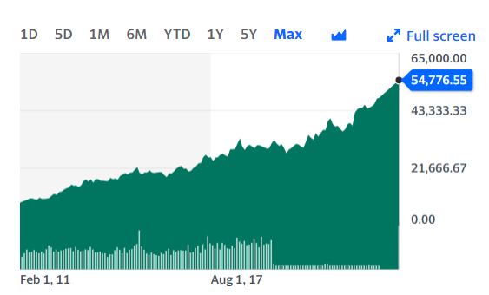
Dataset overview
The Nifty FMCG Index dataset serves as the foundation for our project, offering a comprehensive snapshot of the Fast-Moving Consumer Goods (FMCG) sector on the National Stock Exchange of India (NSE). Understanding the dataset is crucial for deriving meaningful insights into market dynamics.
Key Features:
Date: Timestamp indicating the trading date of the stock data.
Open: Opening price of the FMCG index on a given trading day.
High: Highest recorded price during the trading day.
Low: Lowest recorded price during the trading day.
Close: Closing price of the FMCG index on a given trading day.
Volume: The total number of shares traded on a specific date.

Slide 8
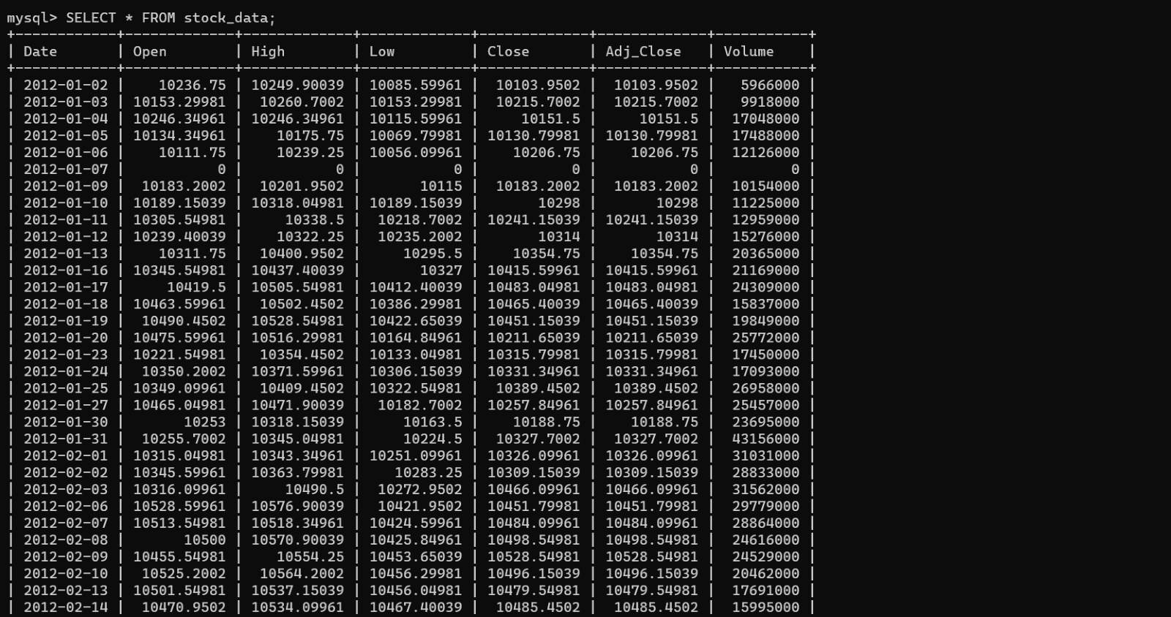
Data Integration
In the initial phase of our project, we successfully loaded the Nifty FMCG Index dataset into a MySQL database. This strategic move provides a robust foundation for efficient storage and retrieval, enabling seamless integration with big data processing tools like Apache Spark.
Database Setup:
Created a MySQL database named "project" for data storage.
Table Creation: Defined a table named "stock_data" to accommodate the dataset's structure.
Loading Data: Utilized MySQL commands or tools to import the dataset into the designated table.

Slide 9
Integration with Spark using JDBC
To harness the power of distributed data processing, we seamlessly integrated the MySQL dataset with Apache Spark using Java Database Connectivity (JDBC). This integration enables Spark to leverage the dataset for scalable and parallelized analysis.
val spark = SparkSession.builder() .appName("JDBC Spark Example") .config("spark.master", "local") .getOrCreate() // Database connection properties val url = "jdbc:mysql://localhost:3306/project" val properties = new java.util.Properties() properties.setProperty("user", "root") properties.setProperty("password", "jaidev@2003")

Slide 10
Data Preprocessing
Data Cleaning
val df = spark.read.jdbc(url, "stock_data ", properties).na.fill(0)
Conversion of date columns
Non-working days in the market has null values, so we had dropped the null values and filled it with 0.
In stock data we can't fill values using any other parameters because no trading happens on those days.

Slide 11
Percentage Change in Closing Price
val percentageChange = df .withColumn("PercentChange", ((col("Close") - lag("Close", 1).over(Window.orderBy("Date"))) / lag("Close", 1).over(Window.orderBy("Date"))) * 100) percentageChange.show()

Slide 12
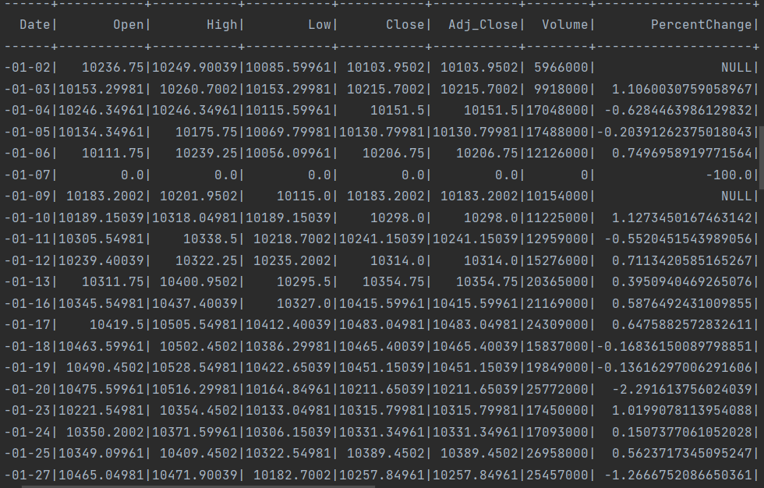
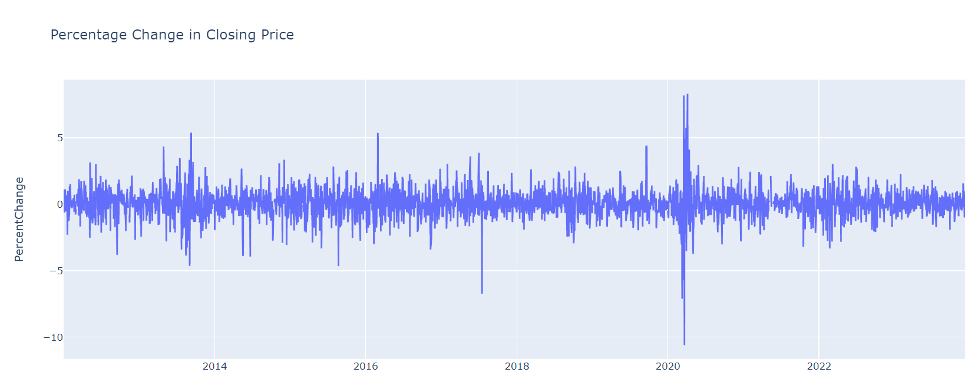
Percentage Change in Closing Price

Slide 13
Market Sentiment Analysis
val marketSentiment = df .withColumn("Sentiment", when(col("Close") > lag("Close", 1).over(Window.orderBy("Date")), "Positive").otherwise("Negative")) .orderBy("Date")

Slide 14
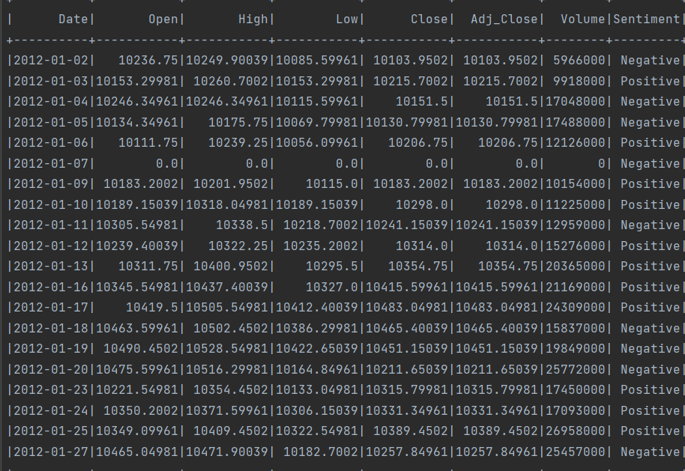
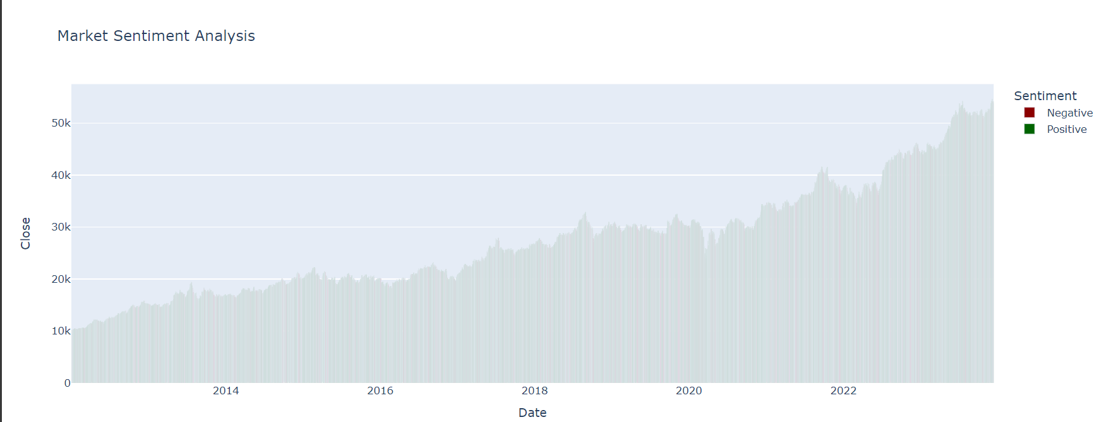
Market Sentiment Analysis

Slide 15
Relative Strength Index (RSI)
val rsiWindow: Int = 14 val rsi = df .withColumn("PriceChange", col("Close") - lag("Close", 1).over(Window.orderBy("Date"))) .withColumn("Gain", when(col("PriceChange") > 0, col("PriceChange")).otherwise(0)) .withColumn("Loss", when(col("PriceChange") < 0, -col("PriceChange")).otherwise(0)) .withColumn("AverageGain", avg("Gain").over(Window.orderBy("Date").rowsBetween(-rsiWindow, -1))) .withColumn("AverageLoss", avg("Loss").over(Window.orderBy("Date").rowsBetween(-rsiWindow, -1))) .withColumn("RS", col("AverageGain") / col("AverageLoss")) .withColumn("RSI", lit(100.0) - (lit(100.0) / (lit(1.0) + col("RS")))) .orderBy("Date") rsi.show()

Slide 16
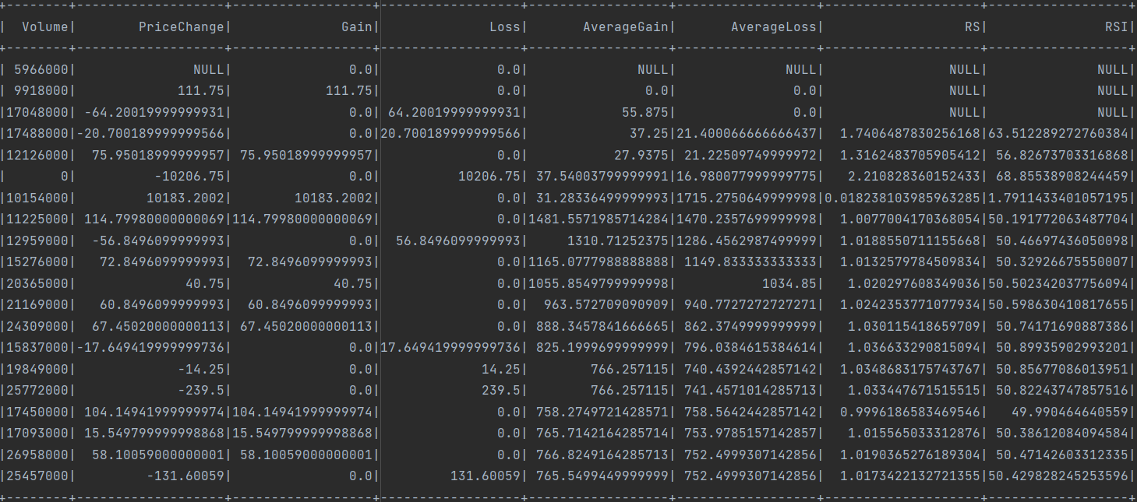
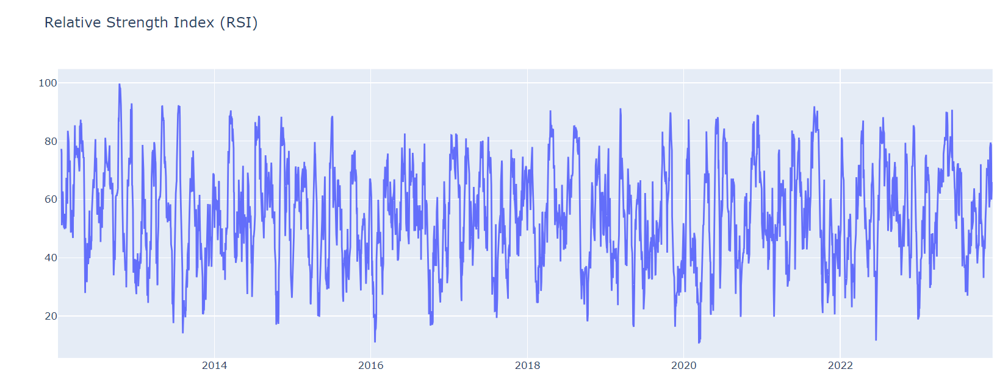
Relative Strength Index (RSI)

Slide 17
Percentage Change in Sales
val salesPercentageChange = df .withColumn("SalesChange", ((col("Volume") - lag("Volume", 1).over(Window.orderBy("Date"))) / lag("Volume", 1).over(Window.orderBy("Date"))) * 100) salesPercentageChange.show()

Slide 18
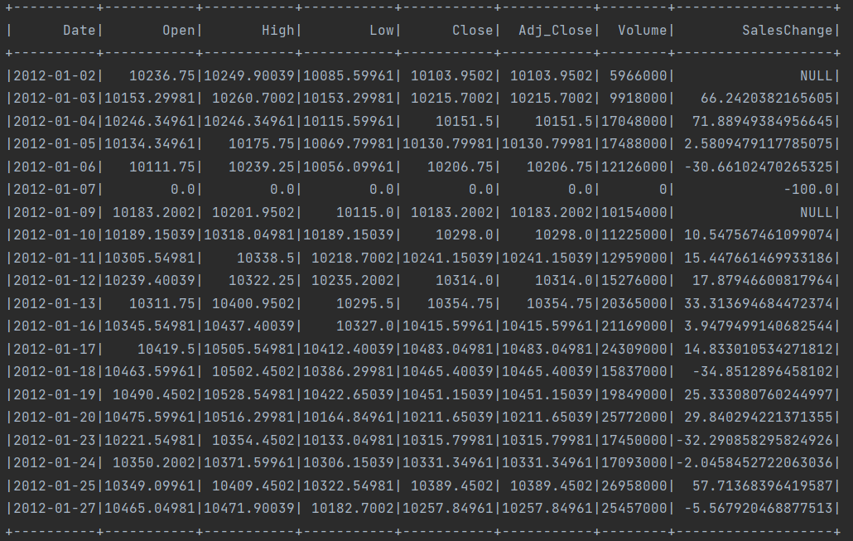
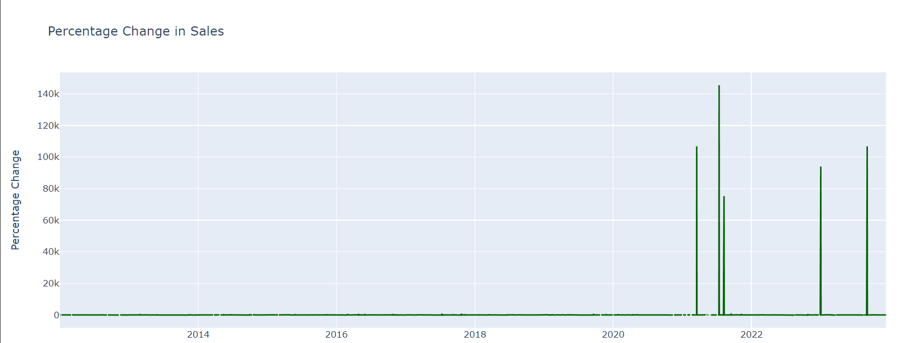
Percentage Change in Sales

Slide 19
Monthly Price Momentum
val monthlyPriceMomentum = df .withColumn("Month", month(col("Date"))) .withColumn("PriceMomentum", col("Close") - lag("Close", 1).over(Window.partitionBy("Month").orderBy("Date"))) .groupBy("Month") .agg(avg(col("PriceMomentum")).alias("AvgPriceMomentum")) .orderBy("Month")

Slide 20
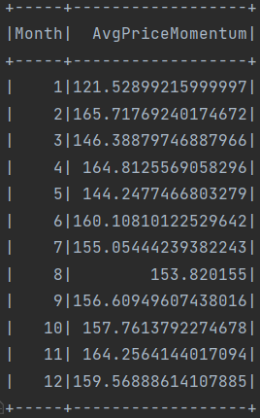
Monthly Price Momentum

Slide 21
Rolling Standard Deviation of Closing Price
val rollingStdDevClosing = df .withColumn("RollingStdDev", stddev(col("Close")).over(Window.orderBy("Date").rowsBetween(-5, 0))) rollingStdDevClosing.show()

Slide 22
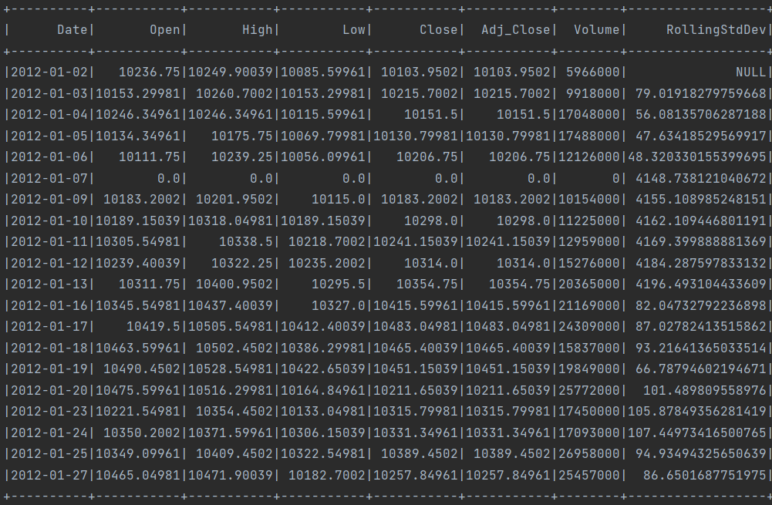
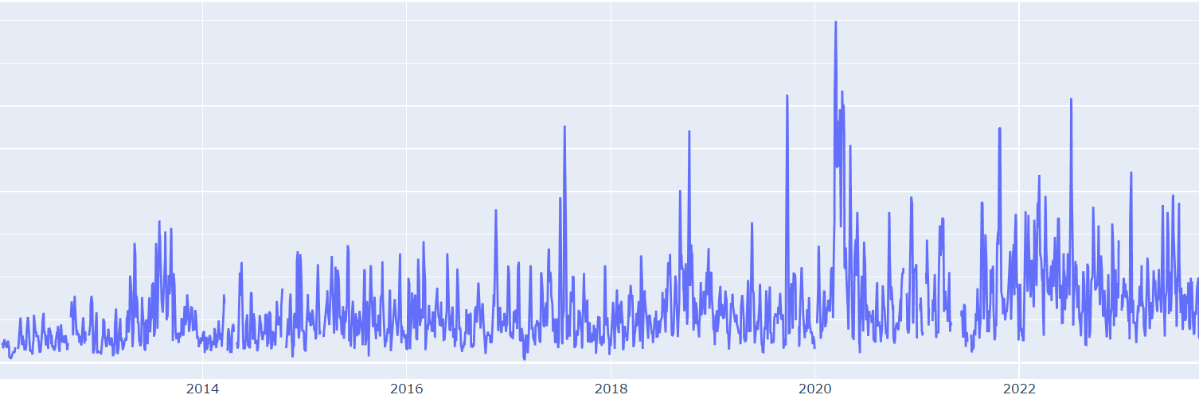
Rolling Standard Deviation of Closing Price

Slide 23
Price and Volume Correlation
val priceVolumeCorrelation = df .select(corr(col("Close"), col("Volume")).alias("Correlation")) priceVolumeCorrelation.show()

Slide 24
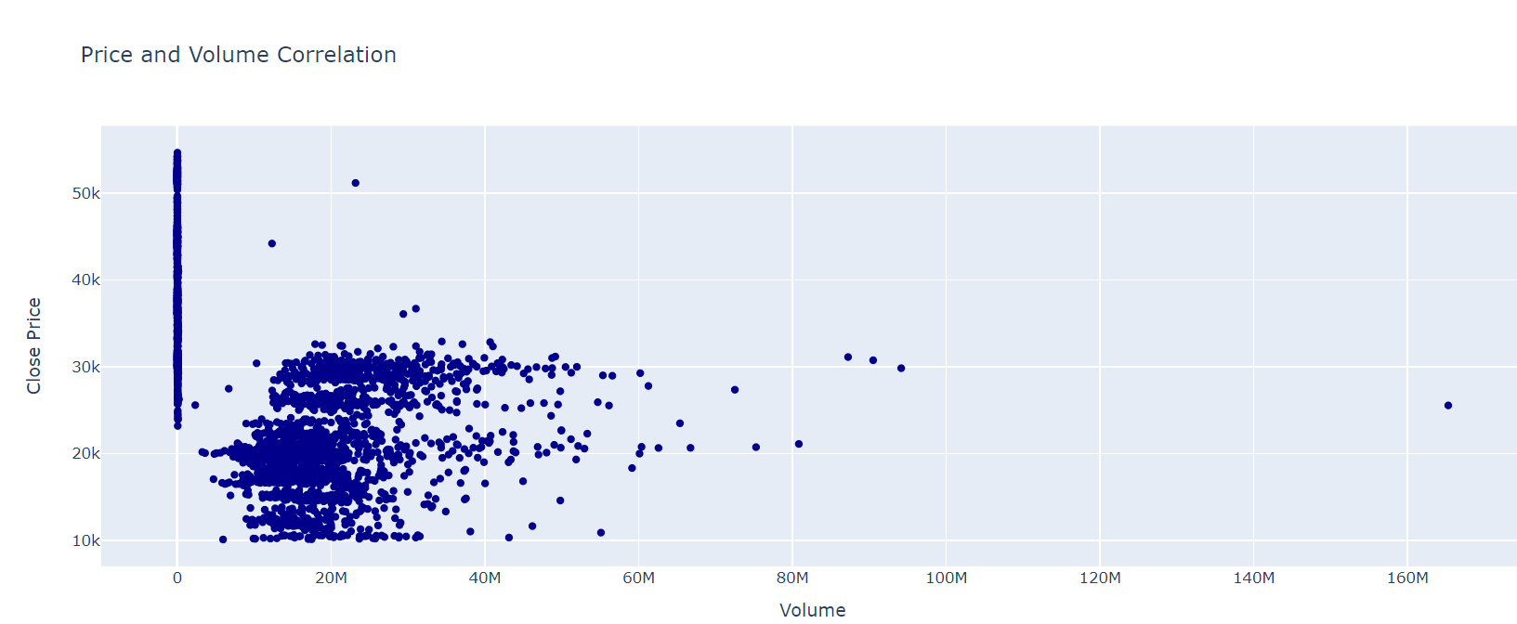
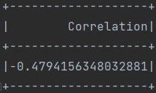
Price and Volume Correlation

Slide 25
Cumulative returns
val cumulativeReturns = df .withColumn("Return", (col("Close") - lag("Close", 1).over(Window.orderBy("Date"))) / lag("Close", 1).over(Window.orderBy("Date"))) .withColumn("CumulativeReturn", sum(col("Return")).over(Window.orderBy("Date"))) .orderBy("Date")

Slide 26
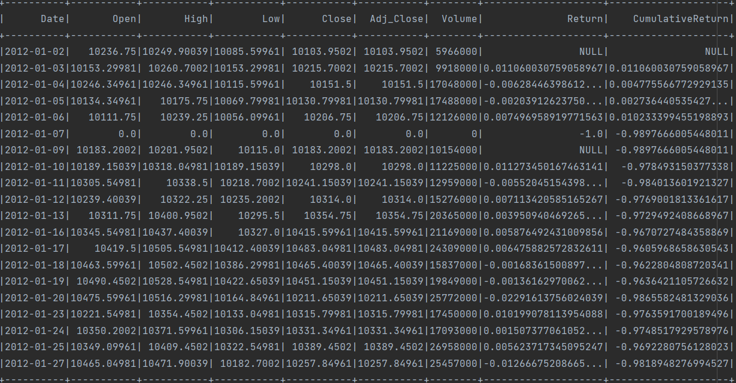
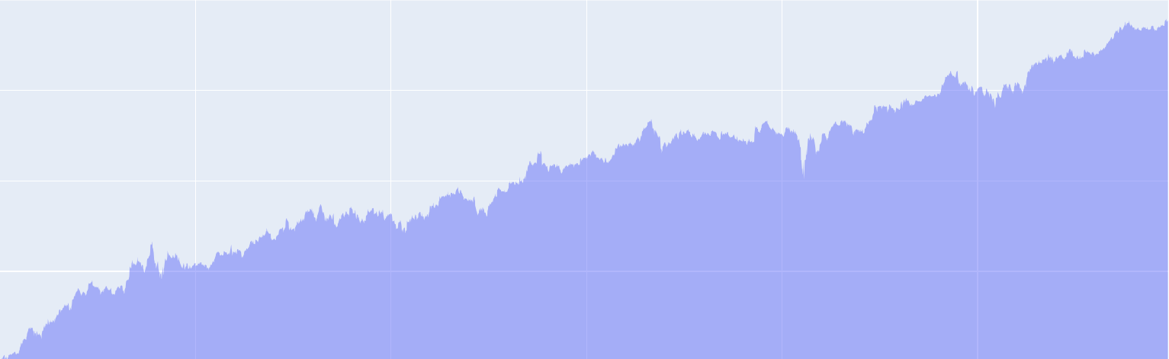
Cumulative returns

Slide 27
Price Gap Analysis
val priceGap = df .withColumn("PriceGap", col("Open") - col("Close")) .orderBy(desc("PriceGap"))

Slide 28
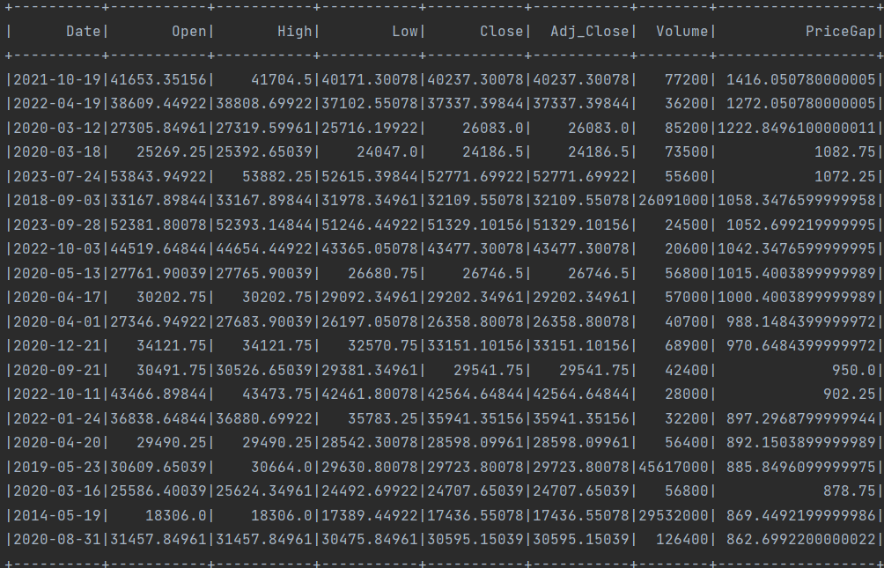
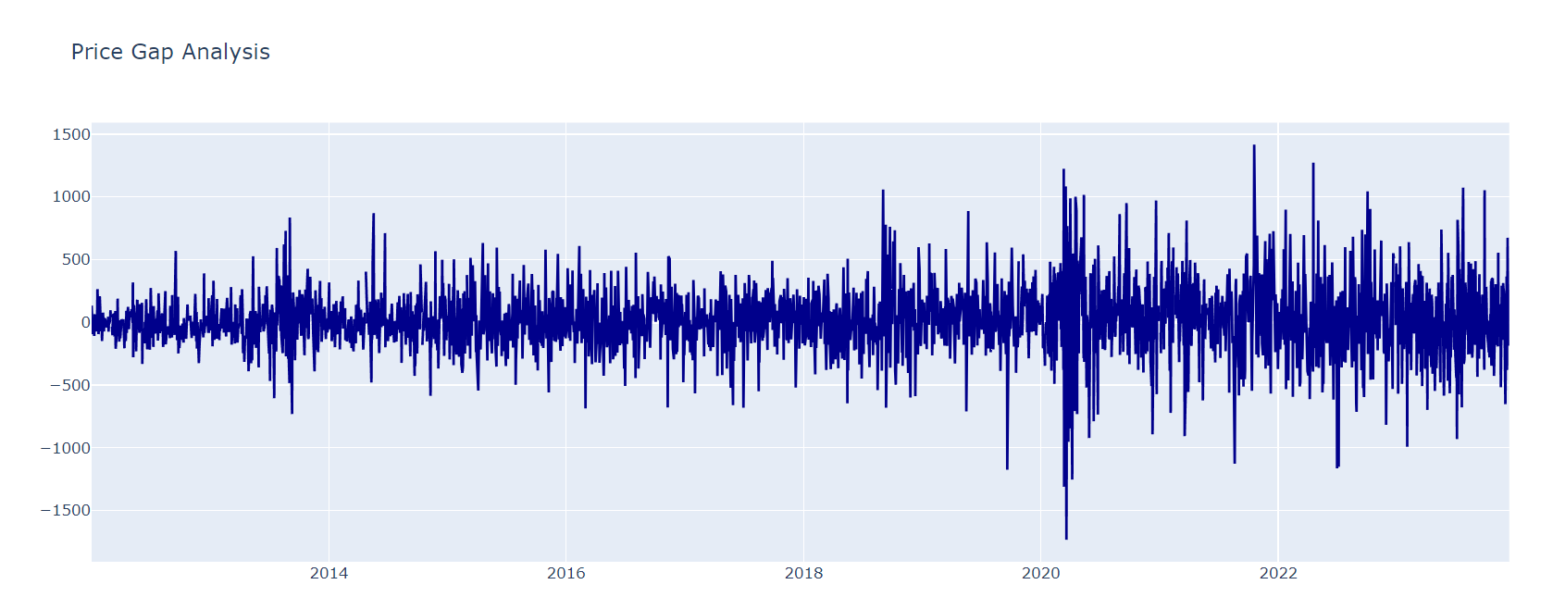
Price Gap Analysis

Slide 29
Moving Average Analysis
val movingAvg = df .withColumn("5DayMovingAvg", avg(col("Close")).over(Window.orderBy("Date").rowsBetween(-4, 0))) .orderBy("Date")

Slide 30
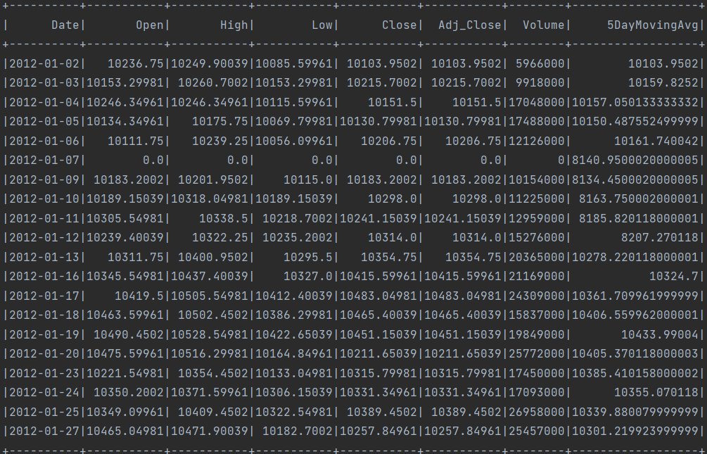
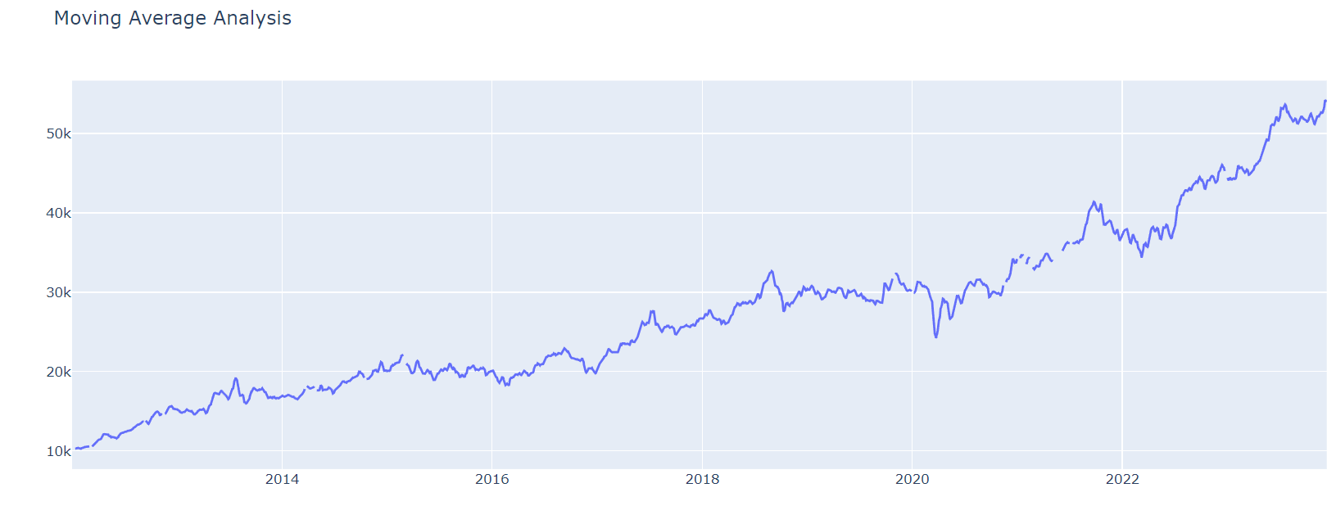
Moving Average Analysis

Slide 31
High-Low Range Analysis
val highLowRange = df .withColumn("HighLowRange", col("High") - col("Low")) .orderBy(desc("HighLowRange"))

Slide 32
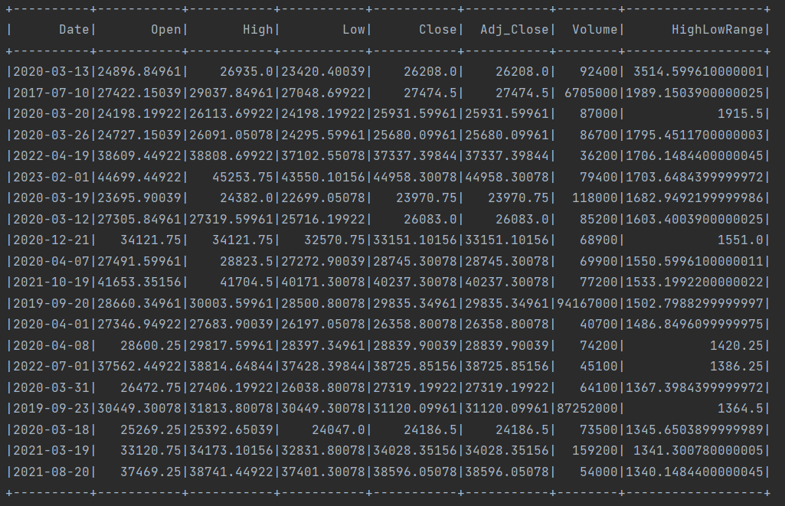
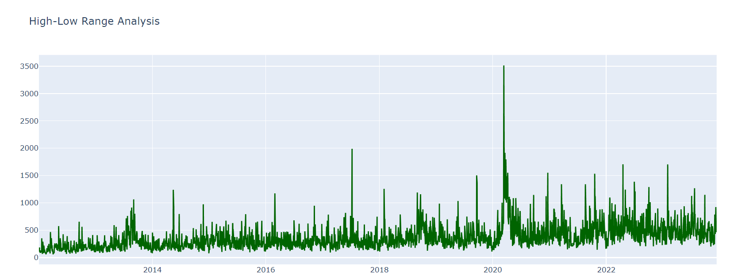
High-Low Range Analysis

Slide 33
Trading Volume Trends
val volumeTrends = df .withColumn("VolumeTrend", col("Volume") - lag("Volume", 1).over(Window.orderBy("Date"))) .orderBy("Date")

Slide 34
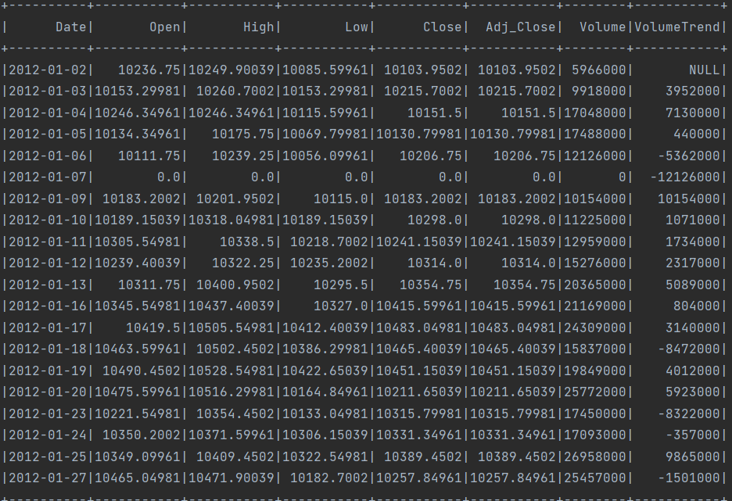
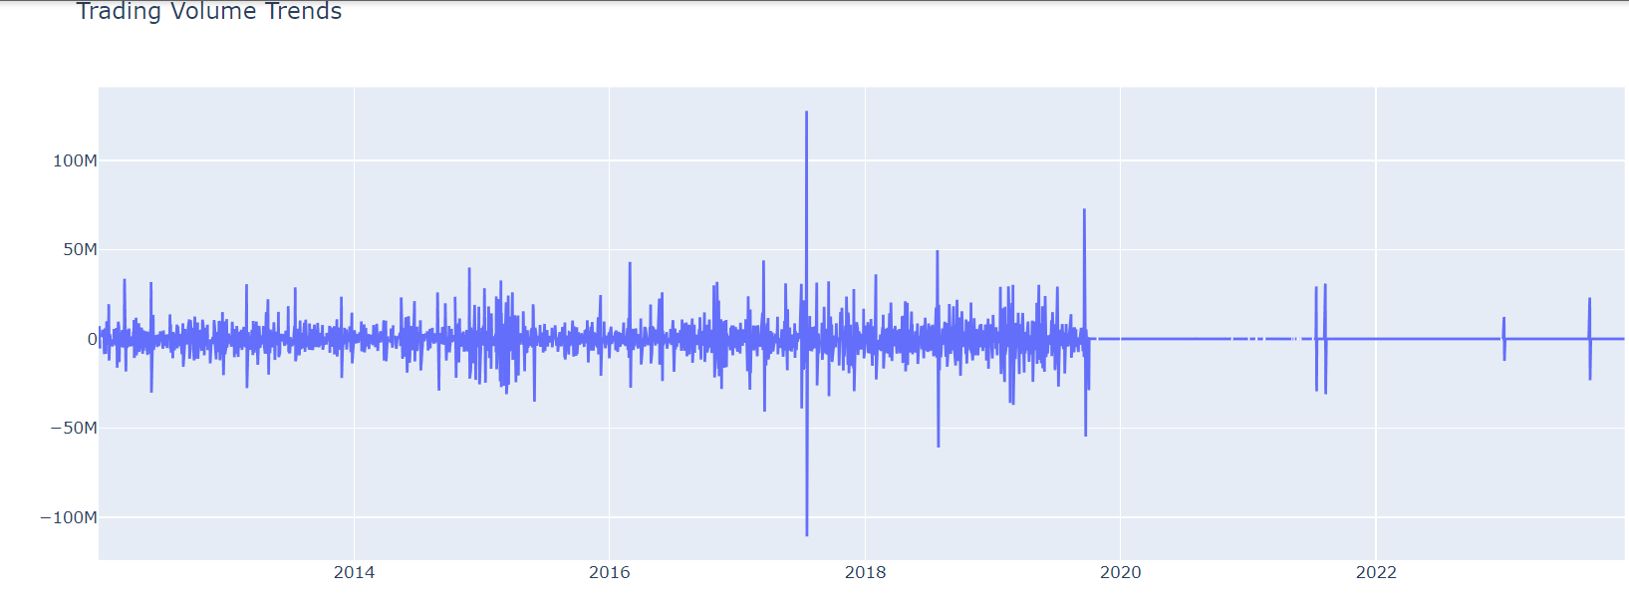
Trading Volume Trends

Slide 35
Machine Learning Predictions
val featureColumns = Array("Open", "High", "Low", "Volume") val assembler = new VectorAssembler().setInputCols(featureColumns).setOutputCol("features") val assembledDF = assembler.transform(df).select("features", "Close") val Array(trainingData, testData) = assembledDF.randomSplit(Array(0.8, 0.2), seed = 1234) val lr = new LinearRegression().setLabelCol("Close").setFeaturesCol("features") val lrModel = lr.fit(trainingData) // Make predictions on the test data val predictions = lrModel.transform(testData) // Evaluate the performance of the model val evaluator = new RegressionEvaluator().setLabelCol("Close").setPredictionCol("prediction").setMetricName("rmse") val rmse = evaluator.evaluate(predictions) println(s"Root Mean Squared Error (RMSE) on test data = $rmse") // Show the predicted values predictions.select("features", "Close", "prediction").show()

Slide 36
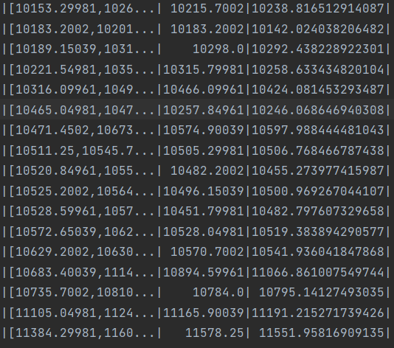
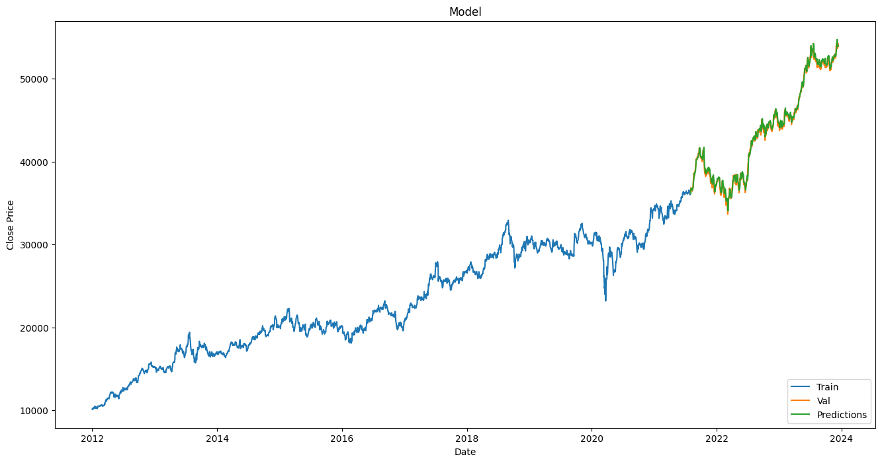
Machine Learning Predictions

Slide 37
GUI
The user-friendly interface provides an intuitive platform for stakeholders to:
Explore Analyses: Navigate through various analyses performed on the Nifty FMCG Index dataset.
Visualize Trends: Access graphical representations of market trends, sentiment, and machine learning predictions.
Customize Views: Tailor the display to specific areas of interest, enhancing the user experience.
Display Database

Slide 38
Future Work
Incorporating External Data Sources
Advanced Machine Learning Models
Real-time Data Processing

Slide 39
Conclusion
In conclusion, our project successfully harnessed the power of big data technologies to analyze the Nifty FMCG Index dataset. Through meticulous data integration, preprocessing, and exploratory analysis, we uncovered valuable insights into market trends and sentiment.
The machine learning predictions using linear regression provided a predictive lens into future market behavior.
The GUI development enhances accessibility, allowing stakeholders to interact seamlessly with the analyzed data.
In achieving our goals, we contribute to a deeper understanding of the FMCG sector, empowering decision-makers with informed insights. The project stands as a testament to the convergence of data science and finance, offering a robust framework for future endeavors.

